Slide 1


Aug 18, 2025
University of Colorado FY25 At A Glance

Slide 2


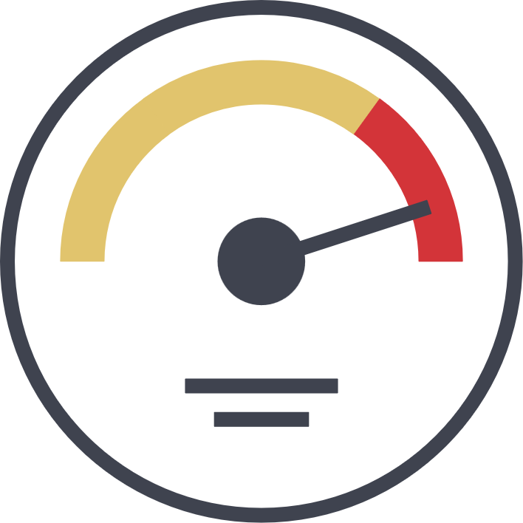



** Excludes: SPO – Construction & SPO Spons Proj Subcontract
Contract Spend = Catalog Spend & Non-Catalog tied to a contract
FY25 At A Glance
S.U.M.**
$1.1B
Contract Spend**
8%
Avg Req Approval
0.76 Days
No Touch Invoices
50%
Approved Contracts
4,527
Approved Suppliers
4,971
Compared to FY24
33% ⬆
PO Spend
78% Catalog Lines
2% ⭣
$2.1M ⬆ On-Contract Spend
0.15 Days ⭣
Invoice (FY25): 1.6 Days (1.4 Day Decrease)
1.9 Days (Check Request Form)
3% ⬆
146.6k Invoices (20k More than FY24)
54% cXML Invs
37% Manual Invs
98%
Used eSignature
15 Avg Days (Create to Workflow Complete)
0.5 Days Decrease
3k PO Suppliers
1.9k Individuals
32 Days – Avg Cycle Time (Form Request to Registration End)

Slide 3

** Excludes: SPO – Construction & SPO Spons Proj Subcontract
FY24 At A Glance
S.U.M.**
$782M
Contract Spend**
11%
Avg Req Approval
0.91 Days
No Touch Invoices
46%
Approved Contracts
3,923
Awarded Events
6
Compared to FY23
4% ⬆
PO Spend
No Change
All Catalog Spend
0.03 Days ⭣
Invoice Approval Time (FY23): 3 Days
0.4 Day Increase
2% ⭣
126.5k Invoices
52% cXML Invoices
100%
Used eSignature
16 Avg Days (Create to Workflow Complete)
68 Awarded in FY22
10 Still Under Evaluation (Closed in FY23)
Contract Spend = Catalog Spend & Non-Catalog tied to a contract

